Slide 1

Tom the IEP Assistant
Created by Thomas Braccia For Microsoft Azure Hack for Accessibility 2021

Slide 2
The challenge Tom was built to solve
“Build an application prototype with Azure for and with people with disabilities in the context of education. The application should be functional with real or sample data”
Tom was built for students with disabilities by ensuring that they have an equal right to an education. As the Education System is in a period of large changes due to the COVID-19 pandemic, this resource is necessary as the switch to remote learning makes it easier for students with disabilities to be left behind. Tom was built with these students in mind as I received feedback from both students and their families in the process of building Tom.

Slide 3
Background
An Individualized Education Plan (IEP) is a map of the special services a student requires if they are to succeed with their disability.
As of 2018-19 14% of all US students were on an IEP.
As long as schools are still open during the COVID-19 pandemic (including remote learning), they are required to continue to serve students with IEPs; however, many schools struggled to properly do this.

Slide 4
Introduction
Tom is an Azure Bot that was created in order to assist both students and their guardians with creating a new IEP as well as ensuring that existing IEPs are being followed.
**Fun Fact: Tom is named after former Iowa Senator Tom Harkin who introduced the Individuals with Disabilities Education Act.

Slide 5
Inspiration and feedback from the community
Tom was inspired by my mother (a special needs educator) and her increased frustration and concern for her students as schools fail to properly follow their IEPs.
Tom supports the setting up IEPs as one main challenge that families face is learning how to begin the process.
My mother also put me in touch with some of her clients and their families to get their feedback while I was working on Tom.

Slide 6
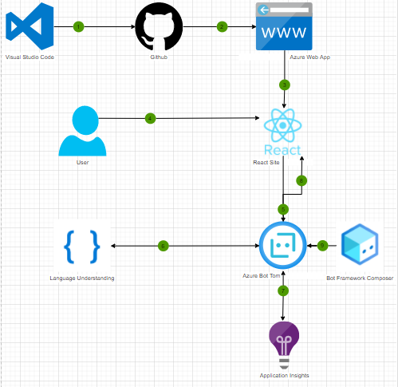
Built With:
Tom was built with Bot Composer Framework to deploy an Azure Bot.
The bot is accessible from a Create React App that is hosted with an Azure Web App.
Tom utilizes Application Insights for improving development.
Tom utilizes Language Understanding (LUIS) for understanding the user and responding to them correctly.

Slide 7
Demo

Slide 8
Challenges faced while building Tom
Finding time to develop Tom while being a full-time student, part-time intern as well as being heavily involved in the university system as midterms approached
Hand-coding the URL creation within the React app, instead of choosing to utilize a package.
Following an iterative approach (in order to incorporate feedback from my mother’s clients) with a limited timeframe and conflicting schedules.

Slide 9
What is next for Tom
Add additional chatbot features for correcting things such as somebody’s name or email (this was not added solely based on time constraints).
Add more questions for the Tom to generate a better email:
Why the students needs or has an IEP, pronouns of the student, name of the school, name of the teacher if they are reaching out to a different faculty member.
Add a connection to a list of Education Advocates and Attorney recommendations that are close to the user if needed.

Slide 10
Sources:
Braccia, Thomas, and Ann Braccia. “Special Needs Educator and IEPs During Covid-19.” 22 Feb. 2021.
Braccia, Thomas, and the Tidwell Family. “Special Needs Education and IEPs During Covid-19.” 24 Feb. 2021.
Braccia, Thomas, and Chapman Family “Special Needs Education and IEPs During Covid-19.” 28 Feb. 2021.
https://nces.ed.gov/programs/coe/indicator_cgg.asp
https://www.understood.org/en/school-learning/special-education-coronavirus-faqs
https://www.education.ne.gov/sped/
https://www2.ed.gov/about/offices/list/ocr/frontpage/faq/rr/policyguidance/Supple%20Fact%20Sheet%203.21.20%20FINAL.pdf
https://www.ncsecs.org/news/covid-19-and-students-with-disabilities/
https://now.tufts.edu/articles/how-covid-19-has-affected-special-education-students
https://www2.ed.gov/about/offices/list/ocr/504faq.html
https://www2.ed.gov/about/offices/list/ocr/docs/504-resource-guide-201612.pdf
https://www2.ed.gov/parents/needs/speced/iepguide/index.html

